Slide 1
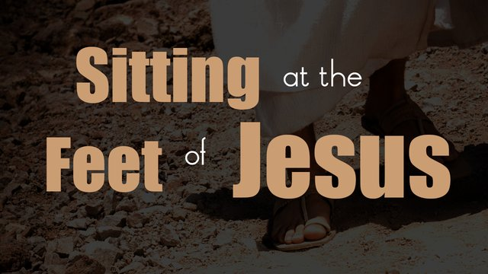

Slide 2

SITTING
Luke 10:38-41
AT THE
FEET
OF JESUS
LET YOUR HOUSE BE A MEETING PLACE FOR RABBIS, AND COVER YOURSELF IN THE DUST OF THEIR FEET, AND DRINK IN THEIR WORDS THIRSTLIY.

Slide 3
Sitting at the Feet
Idiom describing the relationship between Rabbi and student

Slide 4
SITTING
Mary
AT THE
FEET
OF JESUS
Luke 10:38-42
Allowed to study scripture and more
Able to earn the equivalent of a degree
Household duties were required first

Slide 5
SITTING
Scribes
AT THE
FEET
OF JESUS
Mark 2:1-12
Had front row seat
Job was investigate any new Rabbis

Slide 6
SITTING
Disciples
AT THE
FEET
OF JESUS
Matthew 5
The Rabbi sets at an elevated spot
Accommodation for larger crowds
“At His feet” meant most devoted

Slide 7
SITTING
Conclusion
AT THE
FEET
OF JESUS
Mary was anxious to learn.
The scribes couldn’t miss a word.
The disciples learned for three years.

Slide 8

Jesus invites you to sit at His feet and learn His ways.
He wants you to be cleansed and holy.
He can give you the best life any man has ever known.

